Slide 1

Relational DBs & Structure Design

Slide 2
The Bigger Picture
1

Slide 3
The Bigger Picture: Goals
Goals of this lesson:
Learn foundational database concepts such as entities and relationships.
Learn about the different types of entity relationships and how to identify them.
Learn about normalization and how entities and relationships are expressed in a database.
Learn about entity relationship diagrams and how they represent a database's schema.

Slide 4
The Bigger Picture
In the prework, we’ve encountered SQL and used some basic SQL commands. Before we will take a deep dive in the following lecture, we will first take a step back and discuss databases in general.

Slide 5
Entities & Attributes
2

Slide 6
Entities & Attributes
In a relational database we distinguish between:
1.Entity Types
An entity type is a collection of entities with similar attributes.
Entities are instantiated and correspond to the rows.
For instance, we can have the entity type IH Employees with Paolo, Tjerk and Louk (entities) as instances.
Instances of the entity type books are In the Name of the Rose and War and Peace.
2.Attributes
Attributes detail which information about entities needs to be stored.
In data sets on books an instance can have attributes like author = Umberto Eco, publisher = Random House UK, country = Italy;
For another instance, we might have author = Hemingway, publisher = Penguin, country = US.

Slide 7
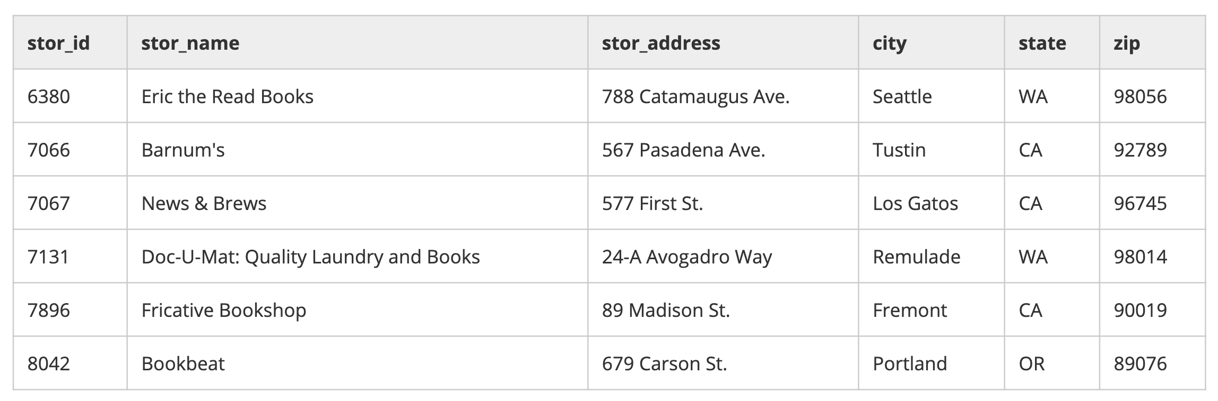
Entities & Attributes
Entity Type
Entity
Roughly speaking, entities correspond to the rows in a dataset and can be understood as instances of an entity type (e.g. books, countries etc.), whereas the attributes correspond to the columns. The attribute of an entity can take on specific values.

Slide 8
Entities & Attributes
Conceptually, we say that an entities’ attributes take a values from a set. For instance, the set of states (i.e. the attribute state) takes values from a set of fixed values. Thus, S = {AL, AK, …, WY}.

Slide 9
Relationships
3

Slide 10
Relationships
We have seen some examples of ‘singular’ entities; cases where we had one entity corresponding to one row. However, in many cases we want to relate one entity type to another.

Slide 11
Relationships
An example of a relationship:
Country
Originates from
Politician
Member of
Party

Slide 12
Relationships
A more complicated example of a relationship:
Located in
Country
Continent
Originates from
Politician
Member of
Beliefs in
Married to
Party
Ideology
Spouse

Slide 13
Relationships
There are three types of relationships
1.One-on-one
If there is a unique one-on-one correspondence between two entities. For instance, social security number and a person.
2.One-to-many
If there is a one-to-many corresponde this means that one entity is related to two or more other entities, but not vice versa. For instance, a book can have many pages, but a page can only have one book.
3.Many-to-many
A book, for instance, can have multiple authors and an author may have written multiple books.

Slide 14
Relationships
One-to-one:
Country
Capital

Slide 15
Relationships
One-to-many:
Books
Chapters

Slide 16
Relationships
Many-to-many:
Authors
Books

Slide 17
Relational DB Design
4

Slide 18
Relational DB Design
The ‘elements’ of a relational database can be grouped as follows:
1.Database
The database proper contains all information. Usually a database is divided into so-called tables.
2.Tables
In tables, the data itself is stored. A table consists of rows and columns, where each row corresponds to an entity and each column represents an attribute of that entity. Thus, each table stores entities.

Slide 19
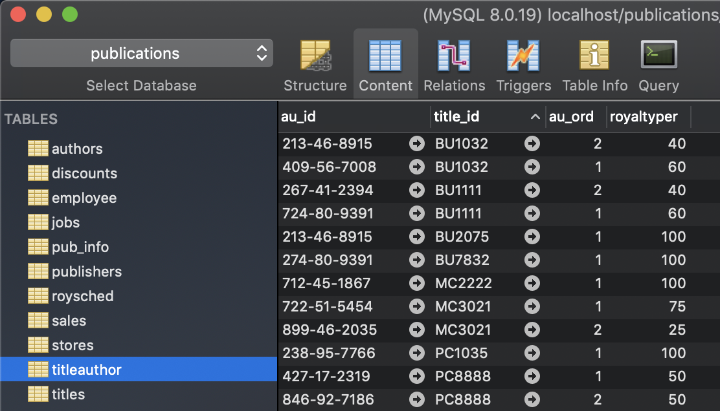
Relational DB Design

Slide 20
Relational DB Design
Because each entity has its own table, we need a way to keep track of the individual entities. We do this with:
1.Primary Keys
The primary key is a unique code that corresponds to a unique instance in the database.
2.Foreign Keys
The foreign key is essentially a column with ID values that refer to the primary key in another table. These do not have to be unique and are meant ‘connect’ one key to another.
Foreign keys are meant to connect two tables.

Slide 21
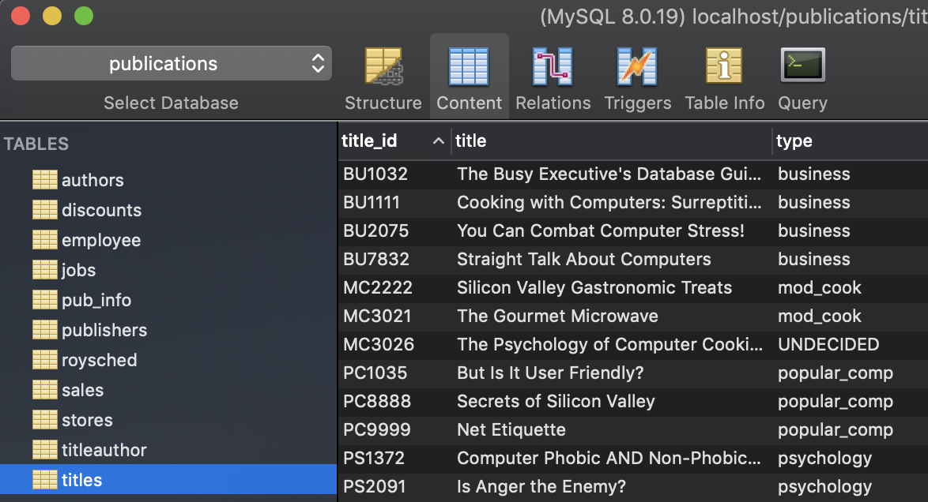
Relational DB Design
Primary key

Slide 22
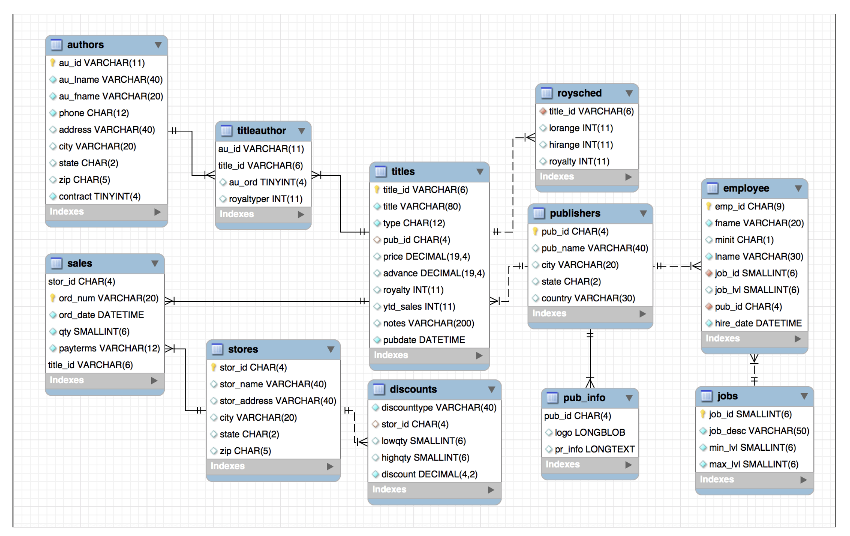
Relational DB Design

Slide 23
Relational DB Design
Foreign Key/ Primary key in titles table
Foreign key

Slide 24
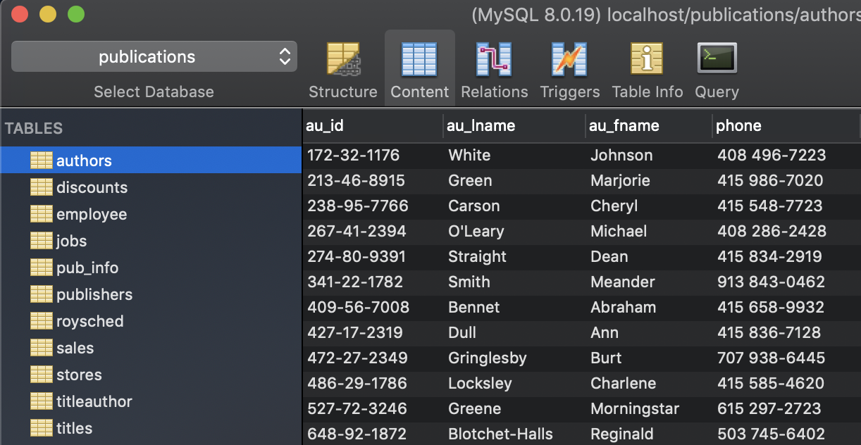
Relational DB Design
Primary key

Slide 25
Relational DB Design
The organisation of the data whereby each table corresponds to an entity and where primary and foreign keys are used to connect the tables of the database is usually referred to as a normalised database.

Slide 26
Entity Relationship Diagram
5

Slide 27
Entity Relationship Diagram
One way to visualise the database as well as the internal relationships between the tables is by making an entity relationship diagram (ERD).
Additional Resource.

Slide 28
Relational DB Design

Slide 29
The End

